Slide 1
Final Project
Management System of Shangrilla Cuisine Restaurant And Function Hall

Slide 2
Introduction
Submitted By :
Abdul Ahad
Roll # MCE-IT-11-43
Supervised By:
Mr Waqas

Slide 3
Introduction Of SHANGRILLA MANAGEMENT SYSTEM
This system is designed in favor of the hotel management which helps them to save the online order of the customer after registration and other things. It helps them from the manual work from which it is very difficult to manage the record of the food category during taking order and it saved all the orders in database.
We design this system on the request of the hotel management, through this they cannot require so efficient person to handle and calculate the things. This system automatically calculates all the price of the foods and provide print facility of invoices.

Slide 4
Project goals and objectives
Goals:
Elimination of paper work for appointment.
Reduce the time.
All requesting clients would be kept their record and can see any time by using their login..
Correctness.
Maintainability.
users needs.

Slide 5
Project goals and objectives
Objectives:
Online management of Shangrilla Restuarant to improve and promote them is the basic objective of this project.
It will also provide an online record and catalogue of Menu and information providing a online order facility with an operating online database.
Increasing the efficiency, saving time and removing human errors during punching order/ data.
Providing accurate information for any customer that has applied for management system when required.

Slide 6
Description & Drawbacks of existing system
Description of existing system :-
The system at present working manually ,that means all the transaction going on within the system is maintain in a ledger book manually thus the management needs to transfer the system as a computerized system .

Slide 7
Description & Drawbacks of existing system
Drawbacks of existing system:-
- Difficulty in maintenance of records. - Time consuming. - Editing of becomes a tedious job. - No security of data. - Mistake occurring in long calculations. - Not proper generation of reports. - High data redundancy. - Data inconsistency. - Customers details can not be search easily

Slide 8
Description of proposed system
Reduced manual work by generating report
Proposed system is user friendly so it is easy to operate
Save time
Ensure data security
Share the student and staff information effectively
System is helpful to see the present status of student
Fast and accurate slip generation

Slide 9
Tool Selection
Selection of the appropriate software is most crucial stage of the development phase. The choice of software tool should be done in keeping view of the problem faced in order to avoid heavy loss of time and money. Tools used for any system development are:
1. Hardware
2. Software

Slide 10
Tool Selection
Hardware:-
For the development and designing of website we had used better hardware for better functioning of the operating system and faster loading of programs. Hardware required to run this system will be:
Machine Intel CORE i3
Processor Intel(R) Core(TM) i3-2370M CPU @ 2.40GHz
RAM 2 GB

Slide 11
Tool Selection
Software:-
Any hardware without software is seemed to be useless in this environment. So different types of software are considered for this specific purpose. Chosen ones are:
Operating System Windows 7/Windows 8
Front end tool HTML, CSS
Back end tool PHP , Java script
Graphic Designing tool Dreamweaver CS6
Database MS SQL
Tools for documentation MS Word

Slide 12
Tools Used for development
Tools and Using Reasons :-
PHP
For making interface and coding.
My SQL
To keep the record of users and their details also for maintaining User personal data for booking request.
MS Word
For ERD diagram, For Use Case diagram ,System Sequence diagram, Sequence diagram.

Slide 13
Tools Used for development
Tools and Using Reasons :-
CSS
For Style.
Java Script
For handle events and form validation.
Dreamweaver CS6
For making interfaces /front –end and admin panel.
HTML
For front end page management.

Slide 14
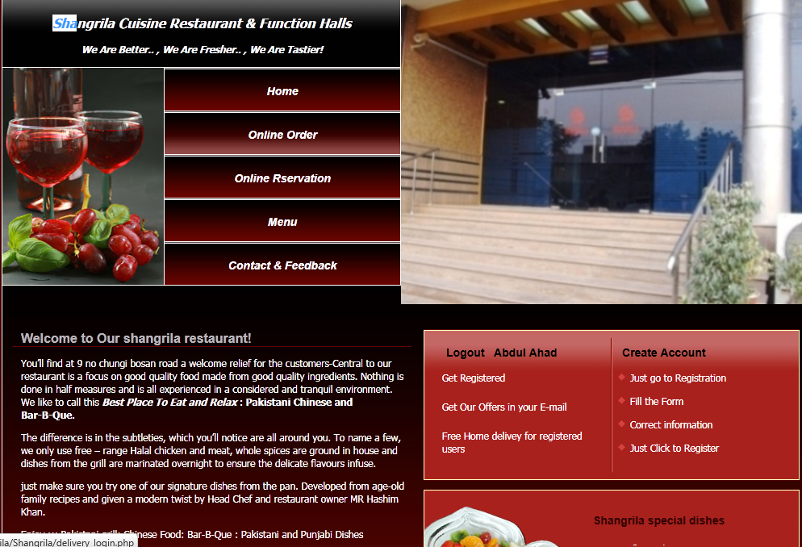
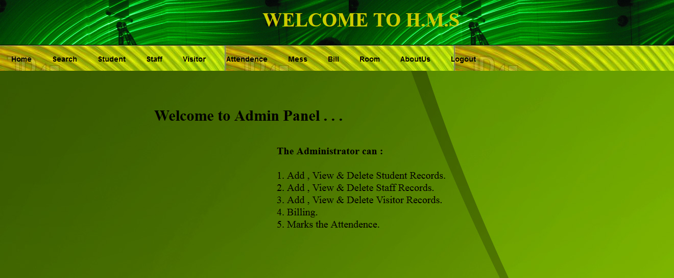
Admin Panel Interface

Slide 15
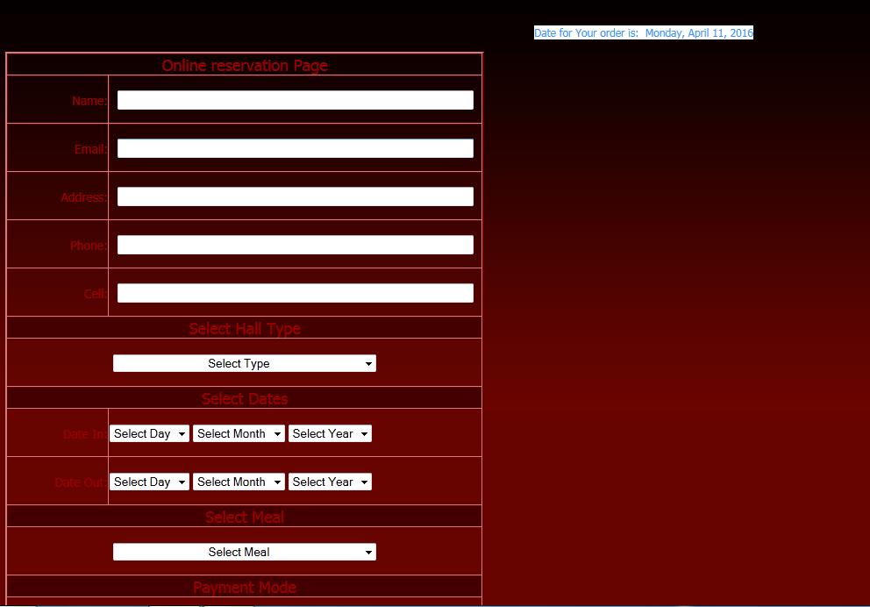
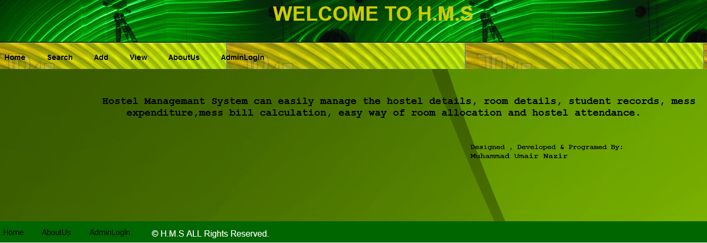
User Interface

Slide 16
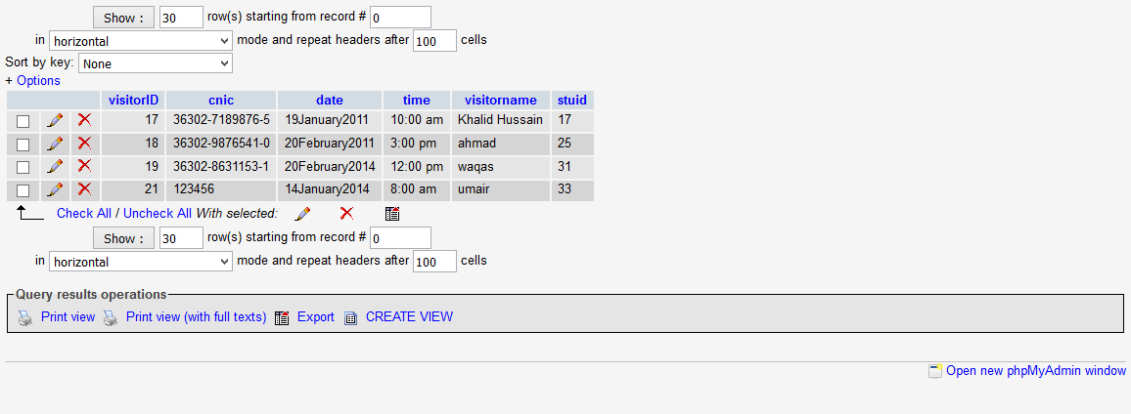
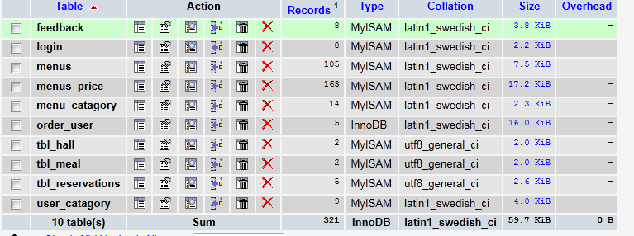
Visitor Date Base

Slide 17
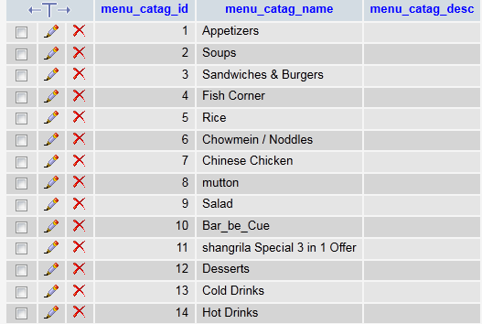
Menu Dat

Slide 18


